Slide 1

第1部分 强化学习基本概念和工具
强化学习实践
强化学习基本概念
强化学习的目标和求解工具

Slide 2
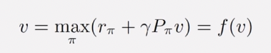
Lecture 3: Optimal Policy and Bellman Optimality Equation
In this lecture:
A core concept：optimal state value and optimal policy
A fundamental tool: the Bellman optimality equation （BOE）
Fixed-point theorem
Fundamental problem
An Algorithm solving the equation
Optimality！

Slide 3
Lecture 3: Optimal Policy and Bellman Optimality Equation
In this lecture:
A core concept：optimal state value and optimal policy
A fundamental tool: the Bellman optimality equation （BOE）
BOE: Introduction
BOE: Maximization on the right-hand side
BOE: Rewrite as v = f(v)
Contraction mapping theorem
BOE: Solution
BOE: Optimality

Slide 4

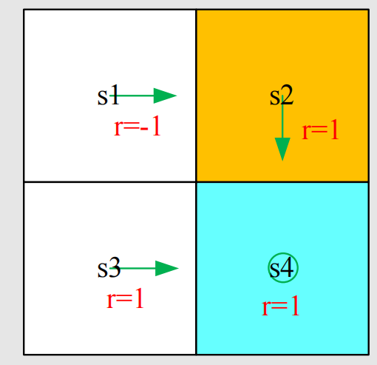
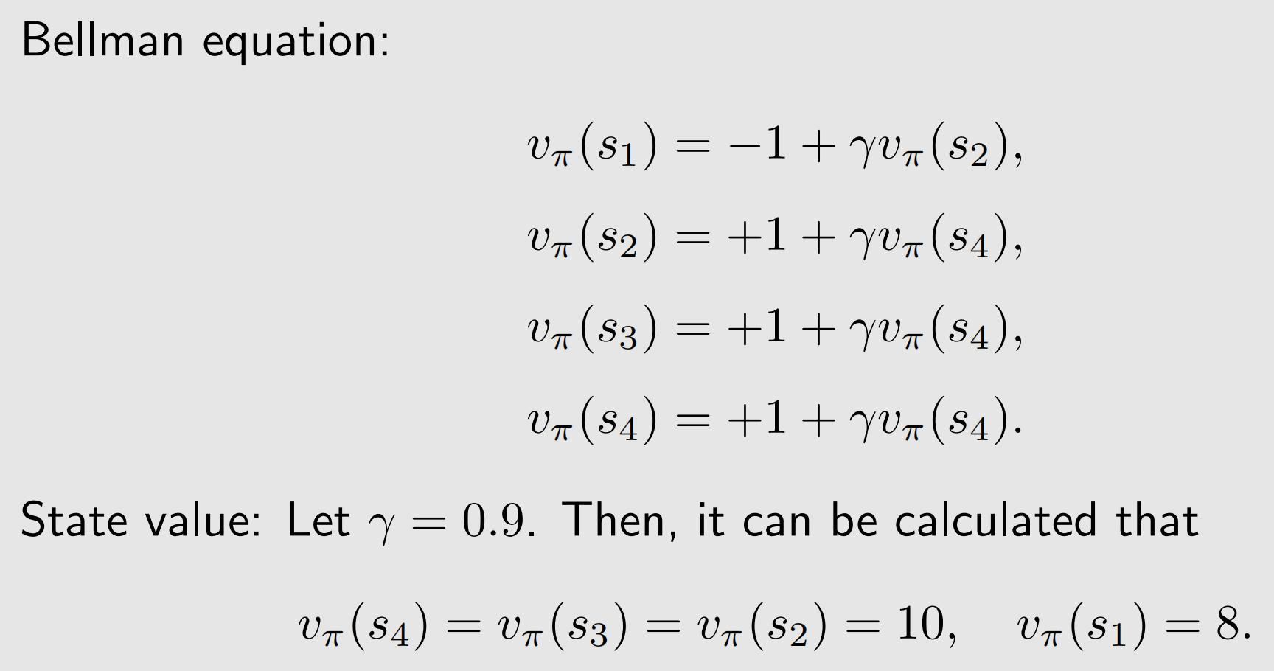
Motivating example

Slide 5
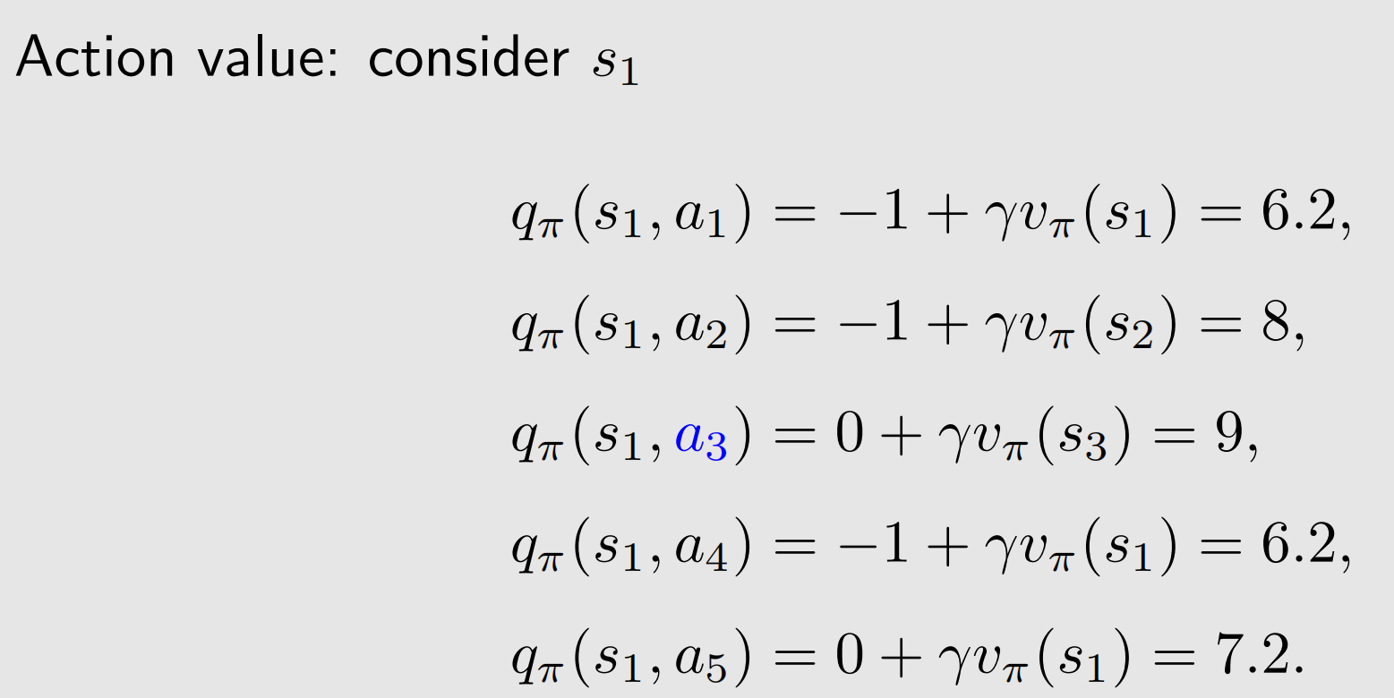
Motivating example

Slide 6
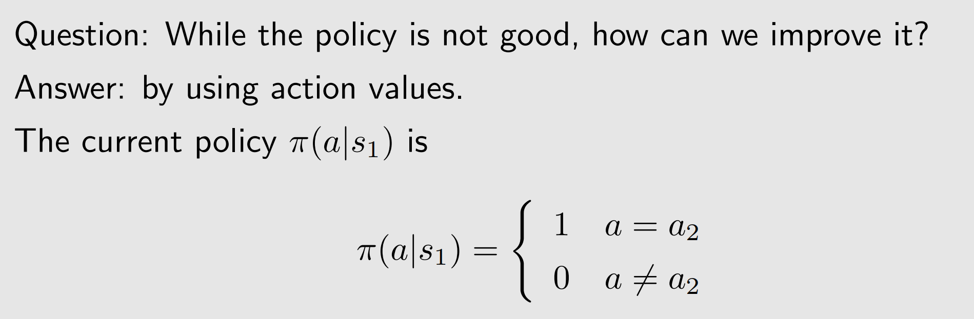
Motivating example

Slide 7
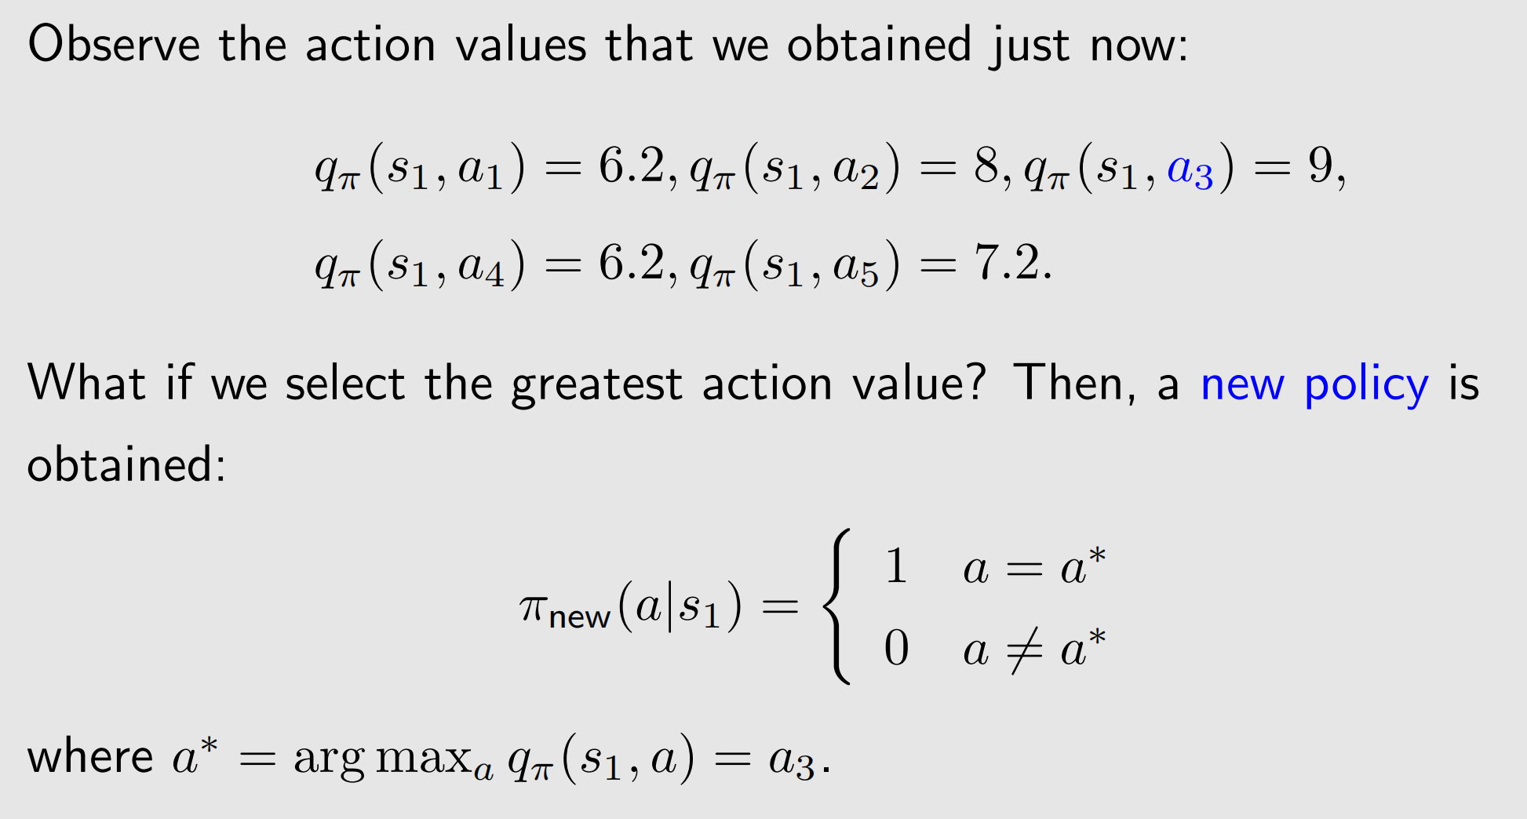
Motivating example

Slide 8
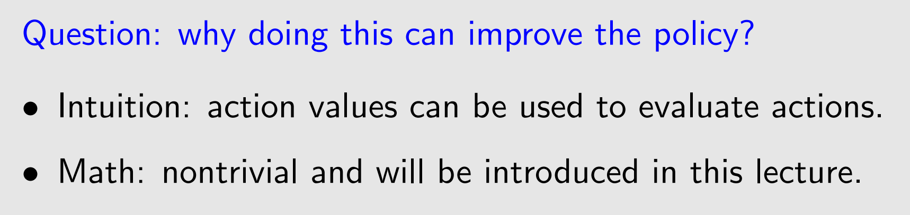
Motivating example

Slide 9
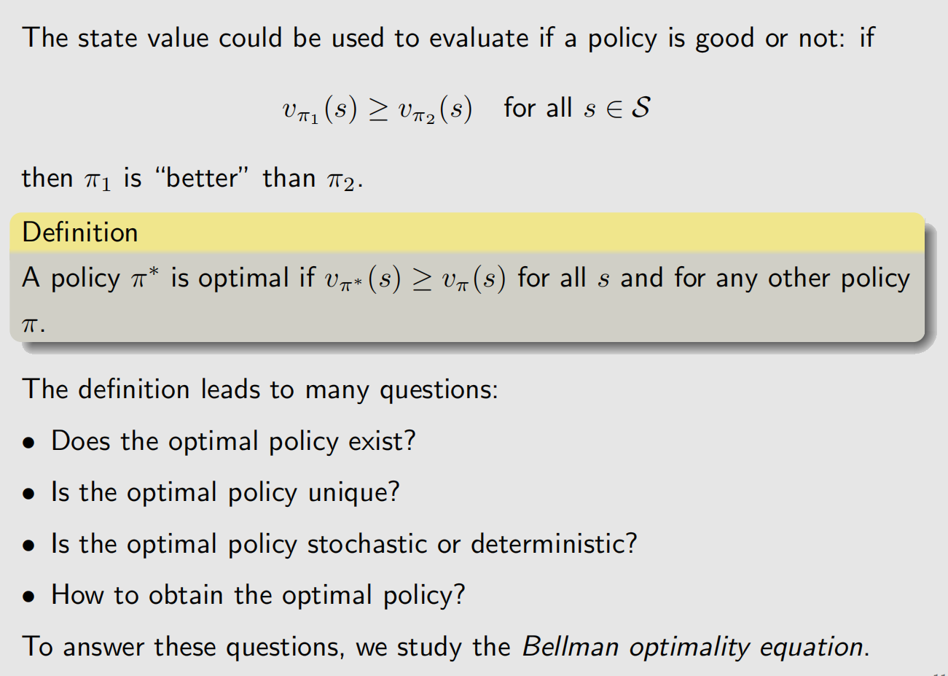
Optimal policy

Slide 10
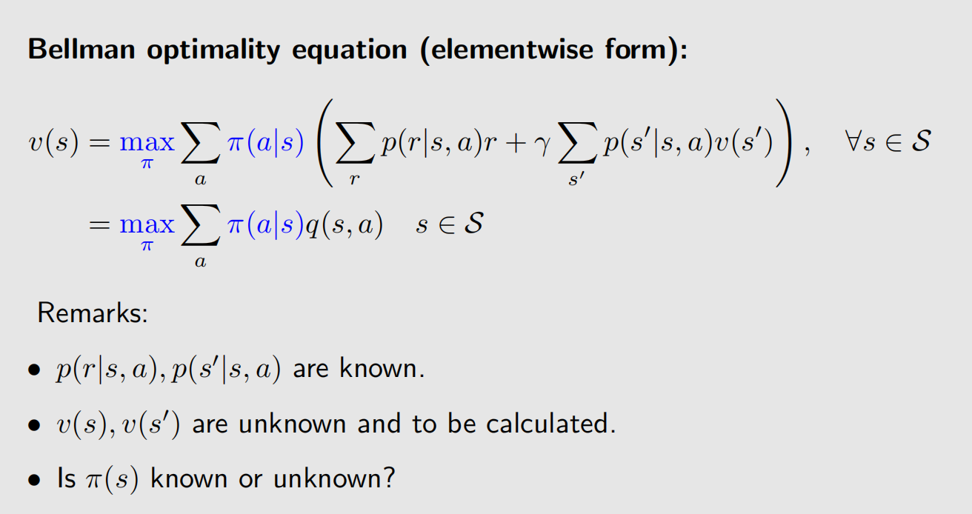
Bellman optimality equation (BOE)

Slide 11
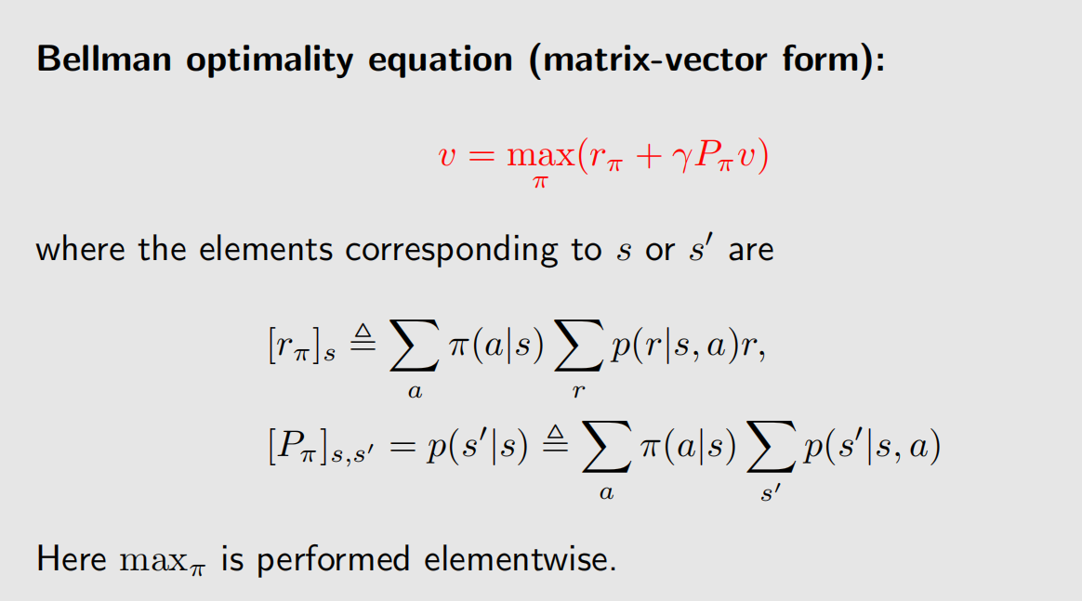
Bellman optimality equation (BOE)

Slide 12
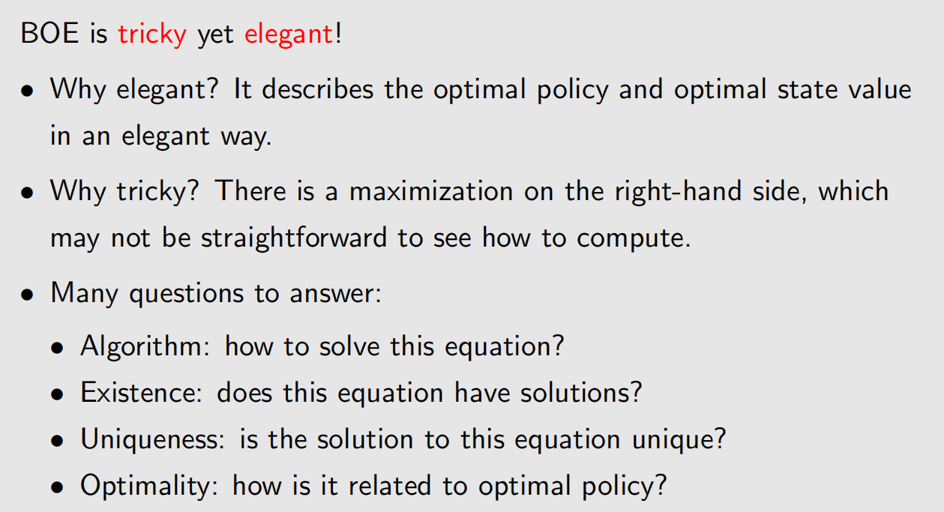
Bellman optimality equation (BOE)

Slide 13
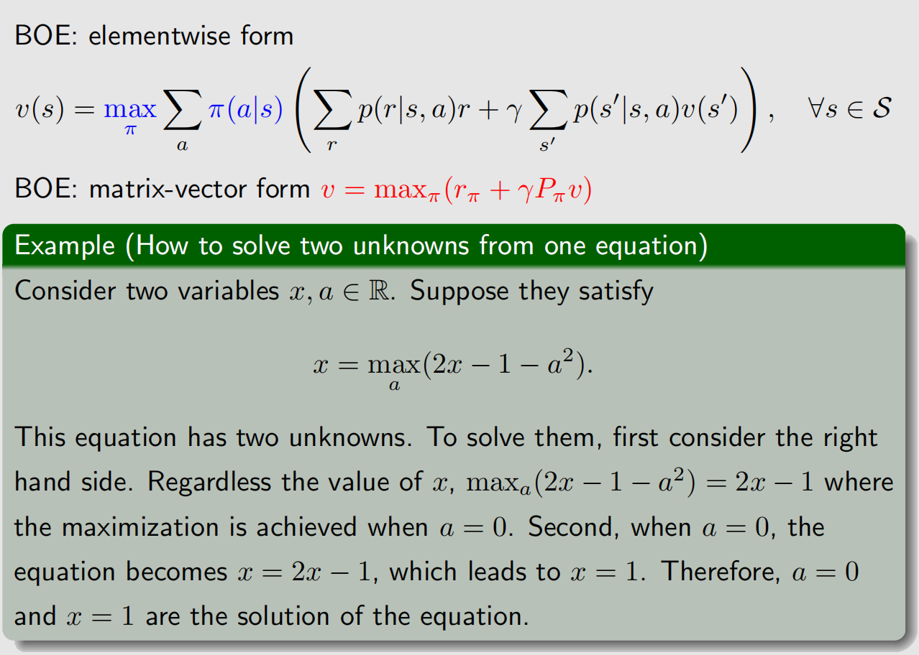
Maximization on the right-hand side of BOE

Slide 14
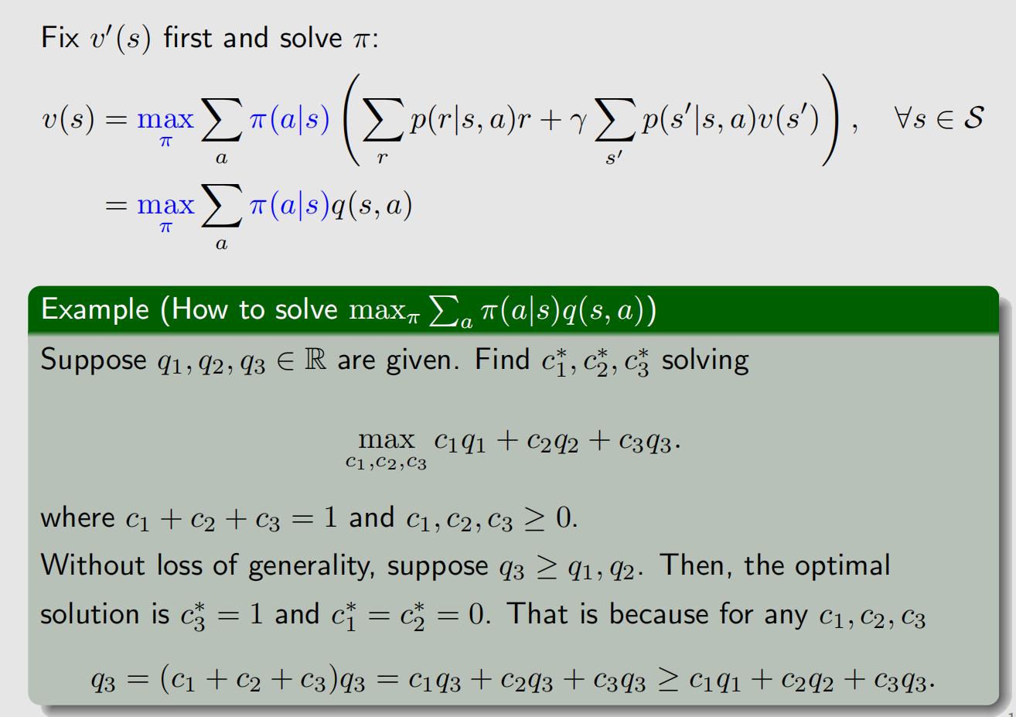
Maximization on the right-hand side of BOE

Slide 15
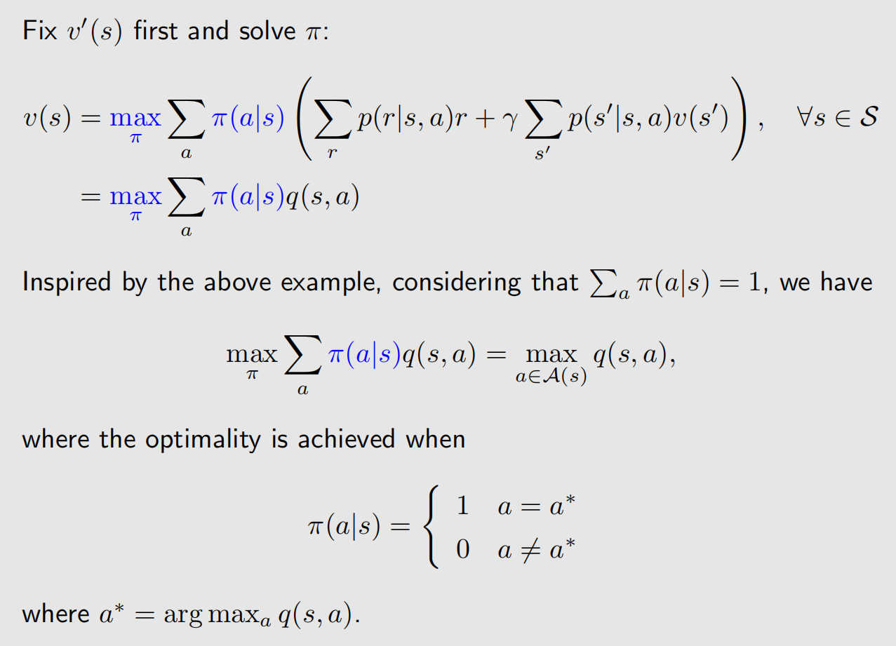
Maximization on the right-hand side of BOE

Slide 16
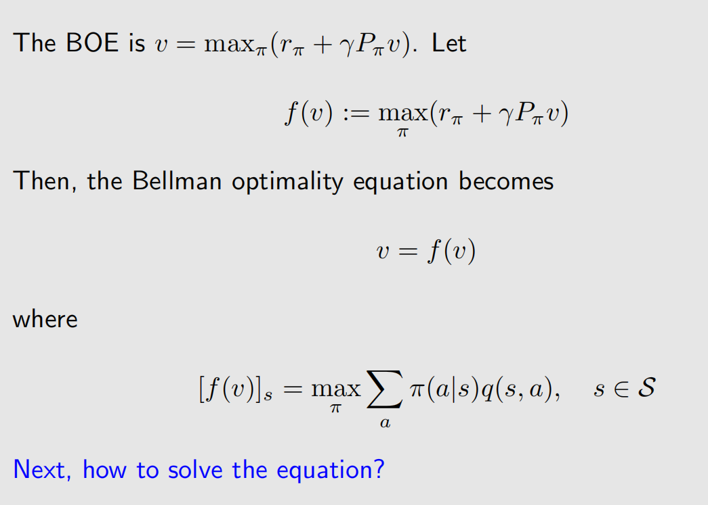
BOE: Rewrite as v = f(v) -> Solve the Bellman optimality equation

Slide 17
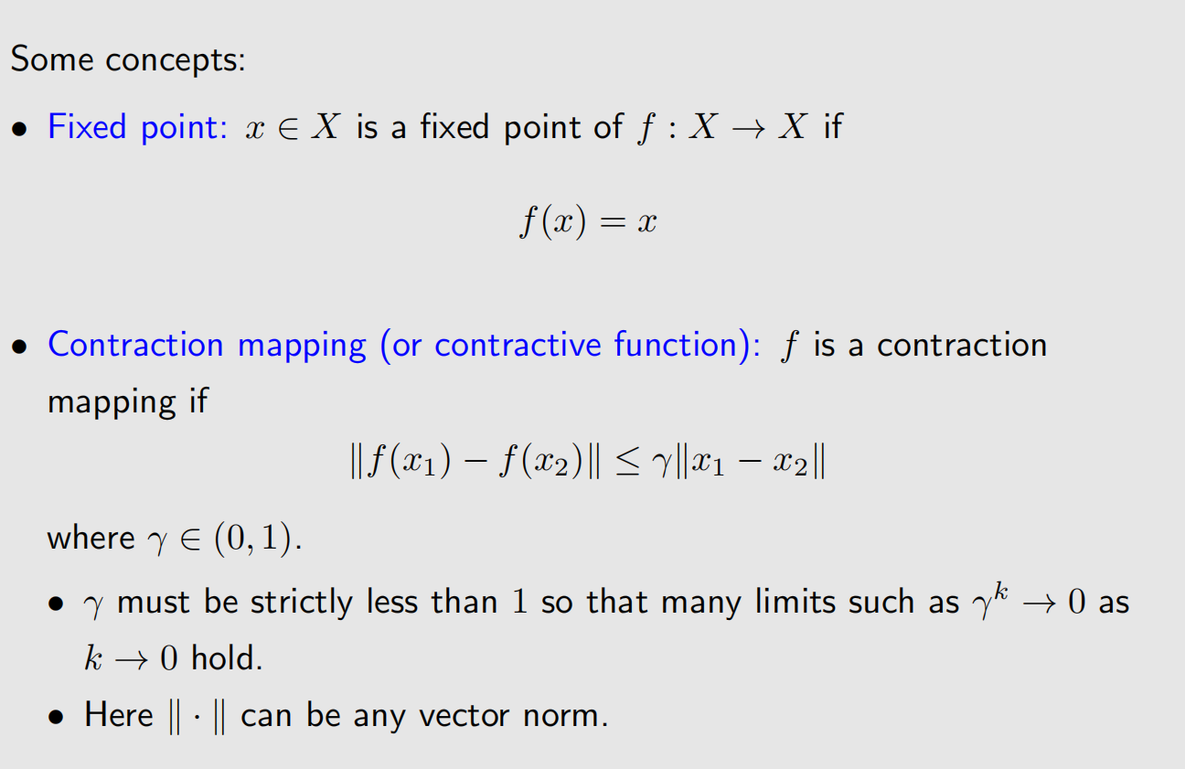
Preliminaries: Contraction mapping theorem

Slide 18
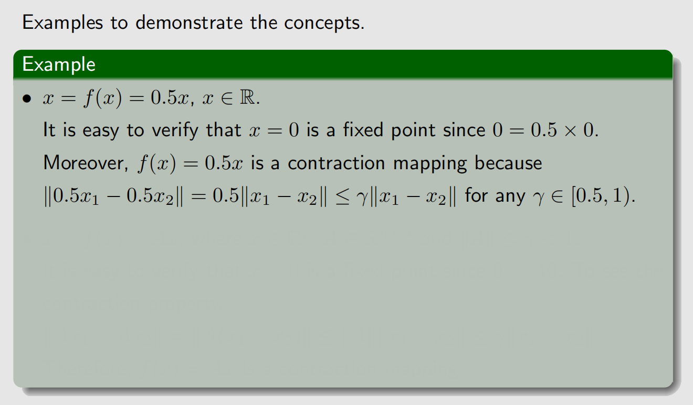
Preliminaries: Contraction mapping theorem

Slide 19
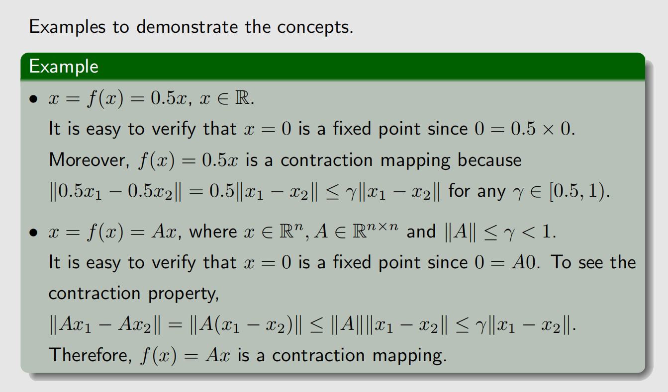
Preliminaries: Contraction mapping theorem

Slide 20
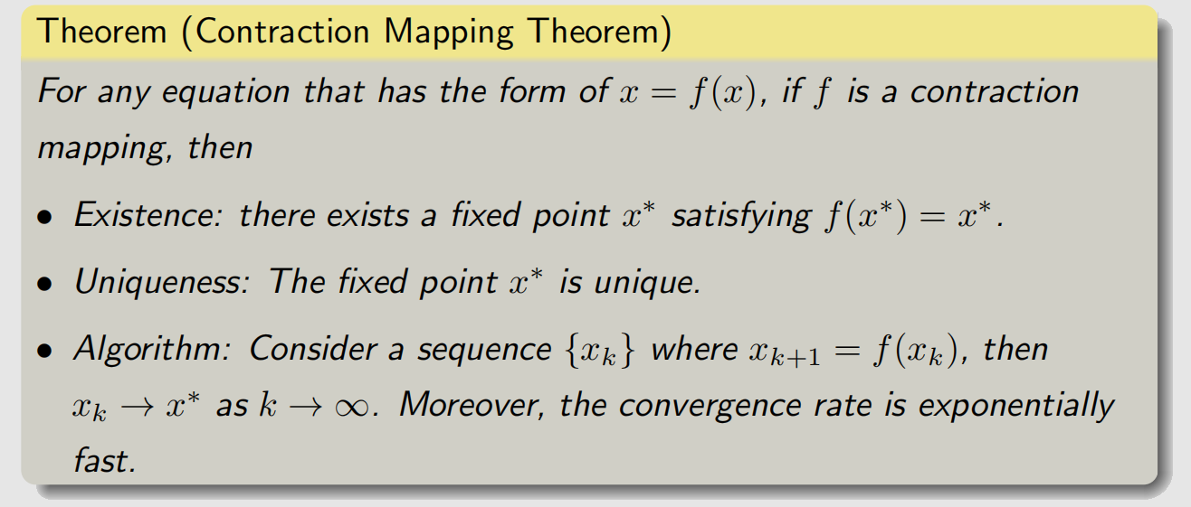
Preliminaries: Contraction mapping theorem

Slide 21
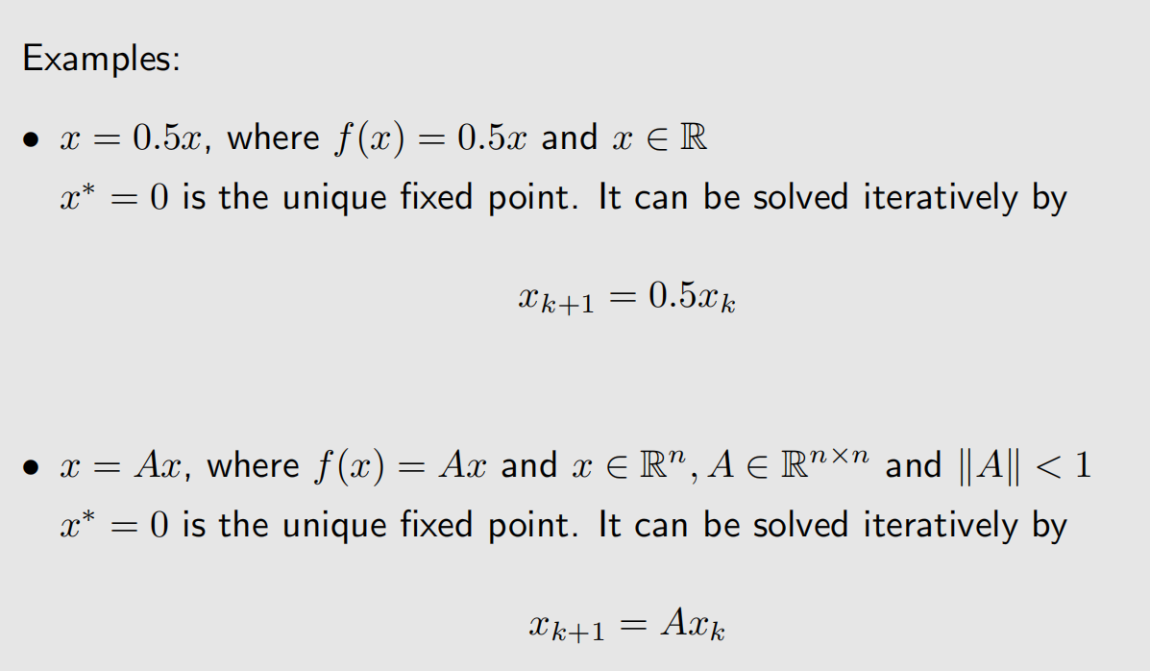
Preliminaries: Contraction mapping theorem

Slide 22
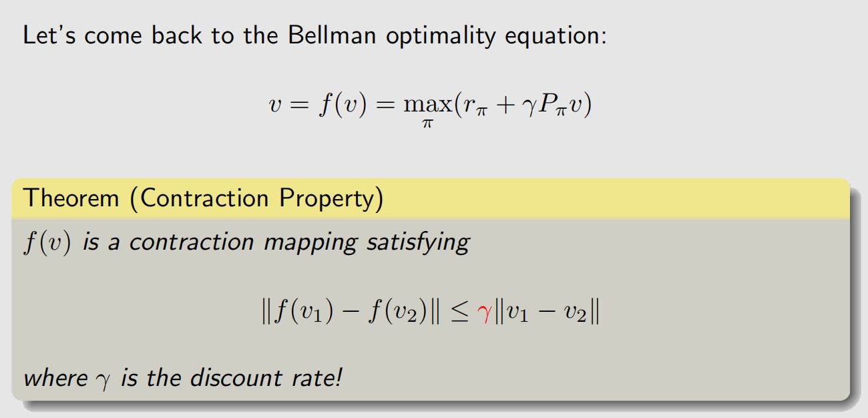
Contraction property of BOE

Slide 23
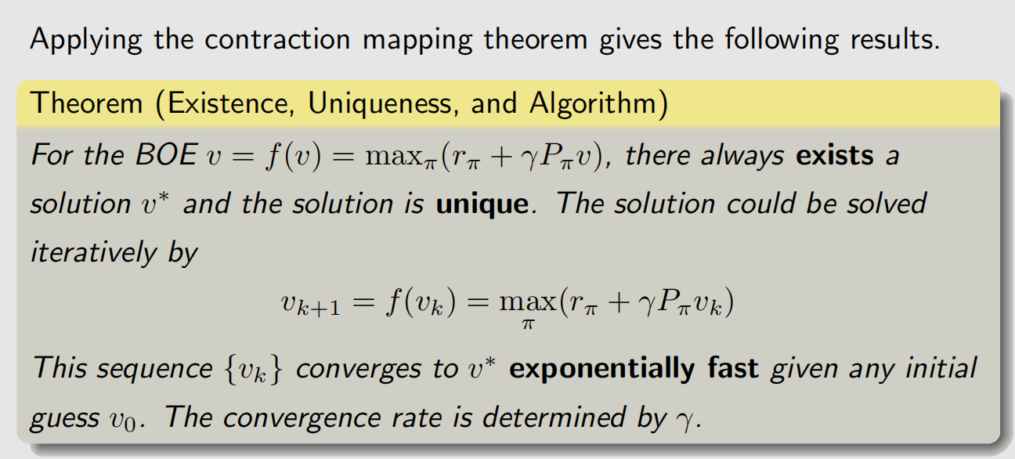
Solve the Bellman optimality equation

Slide 24
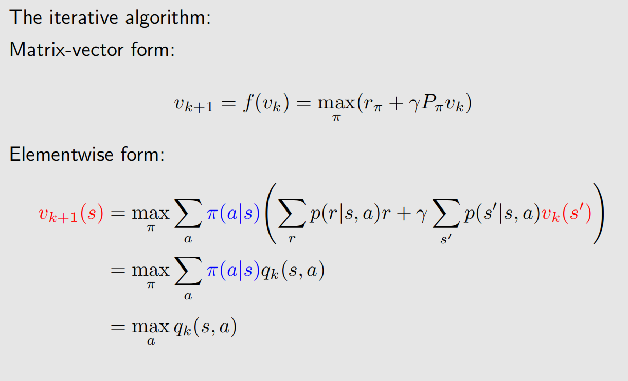
Solve the Bellman optimality equation

Slide 25
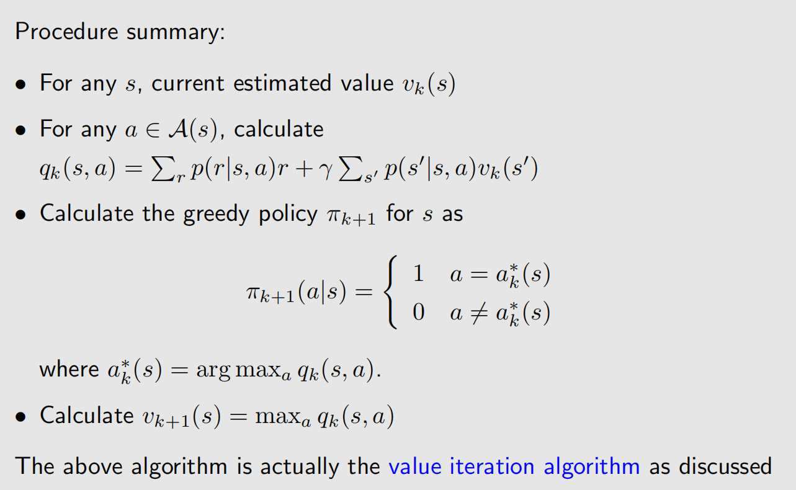
Solve the Bellman optimality equation

Slide 26
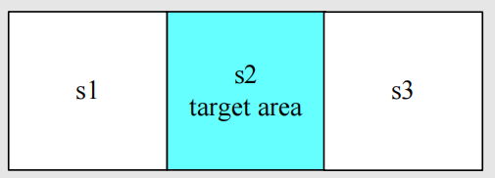
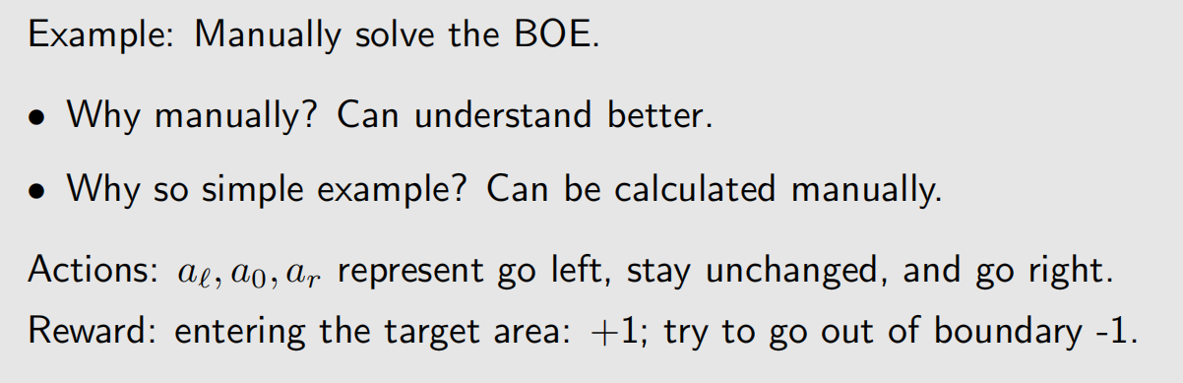
Example

Slide 27
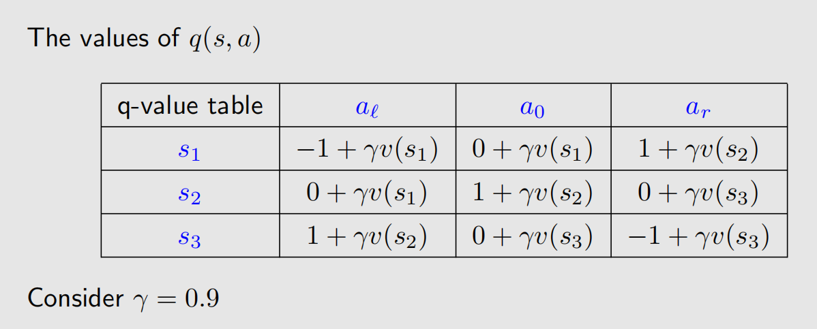
Example

Slide 28
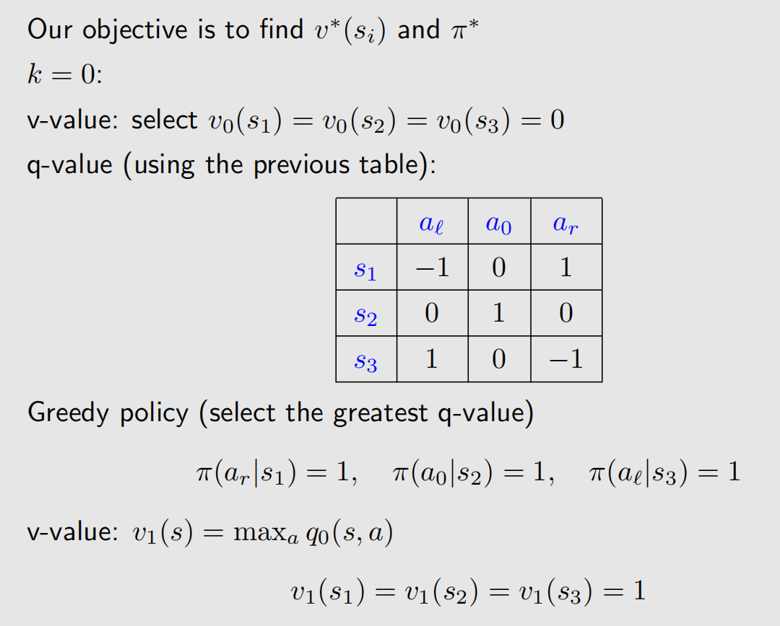
Example

Slide 29
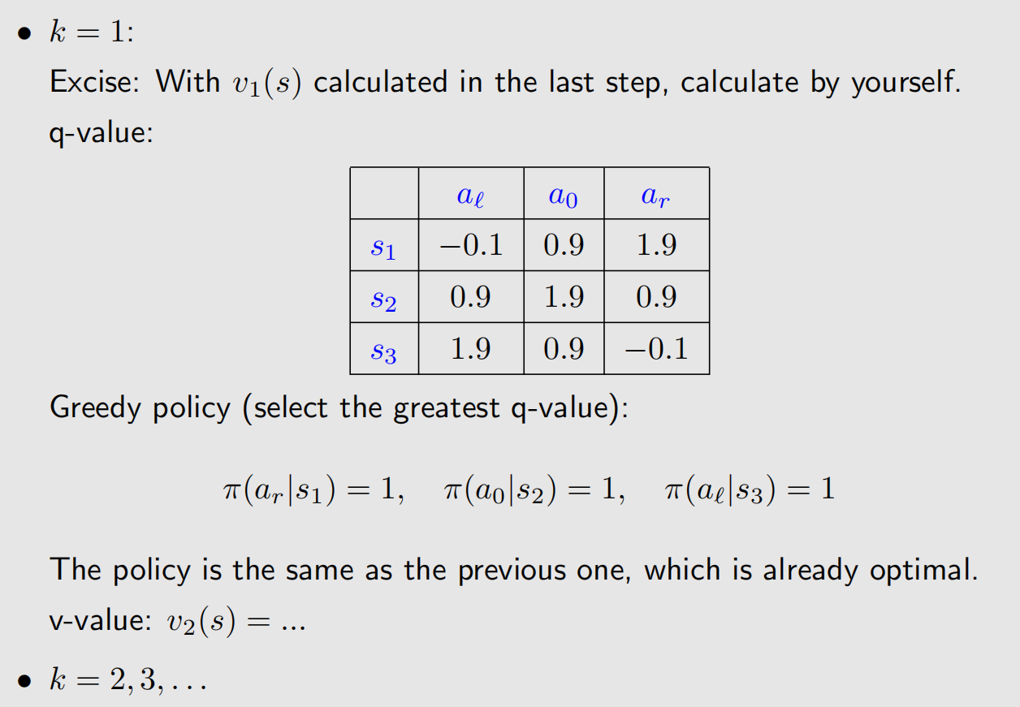
Example

Slide 30
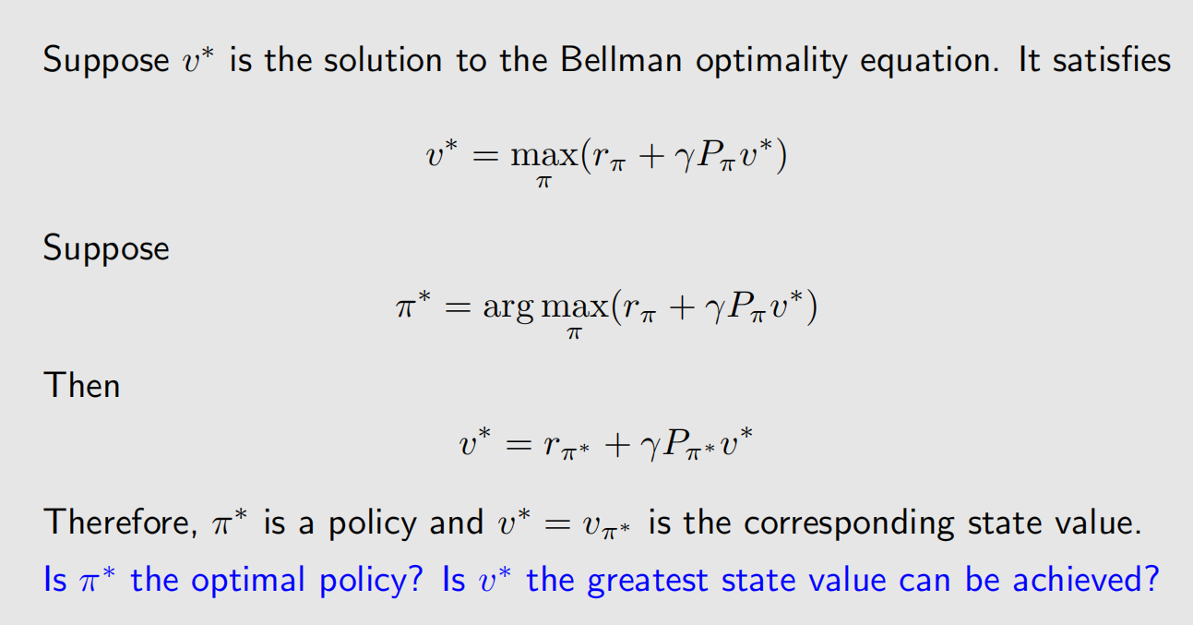
Policy optimality

Slide 31
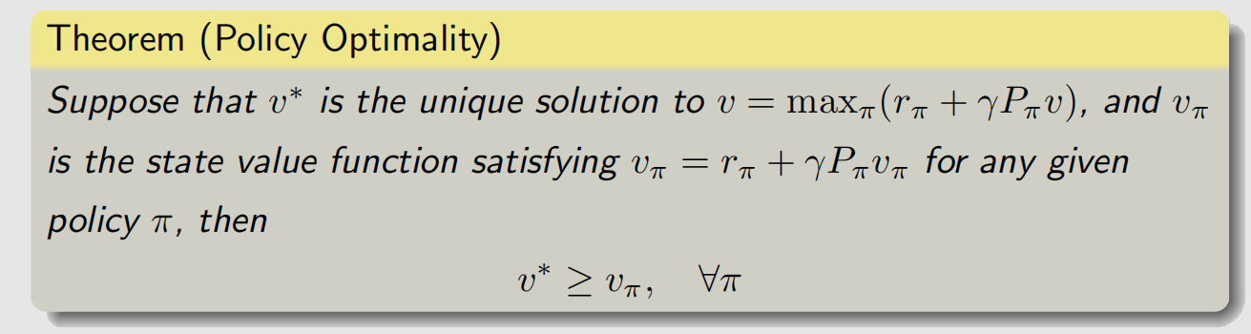
Policy optimality
Now we understand why we study the BOE. That is because it describes the optimal state value and optimal policy.

Slide 32
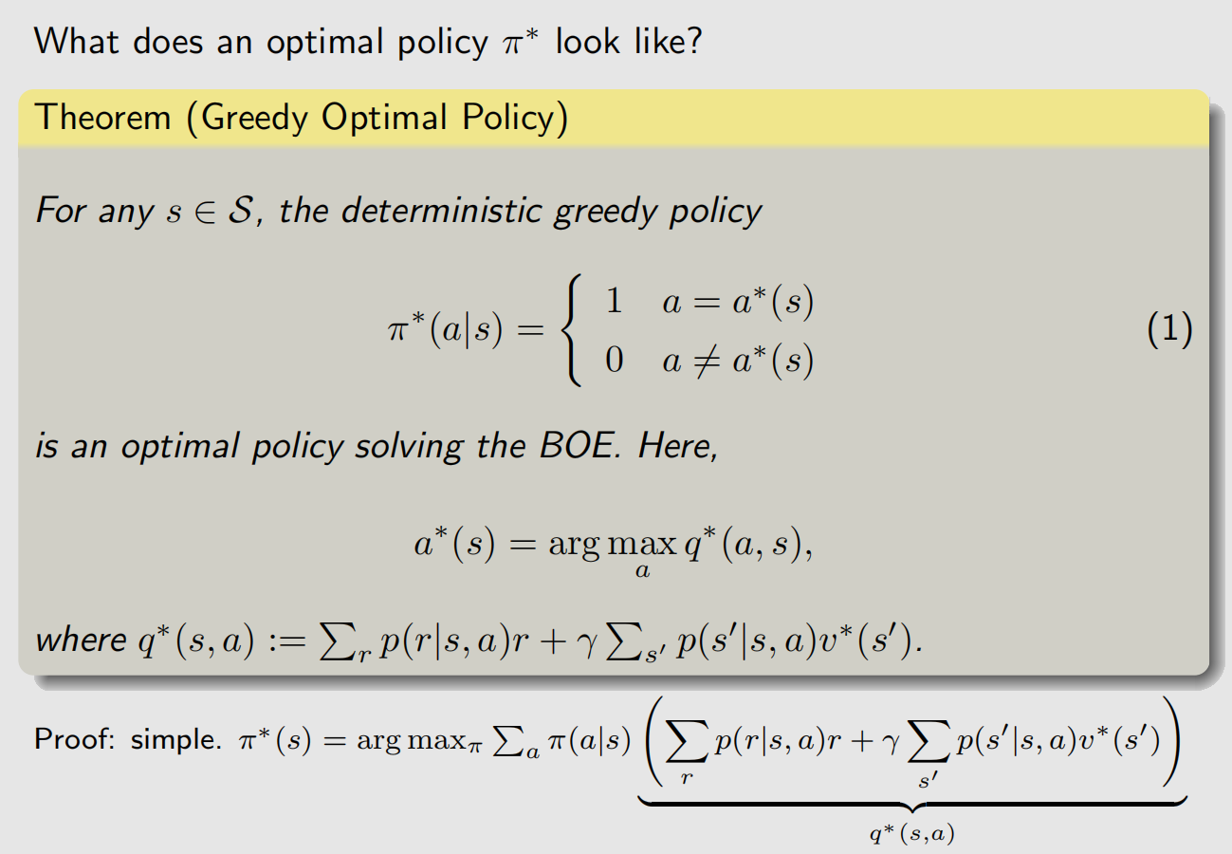
Policy optimality

Slide 33
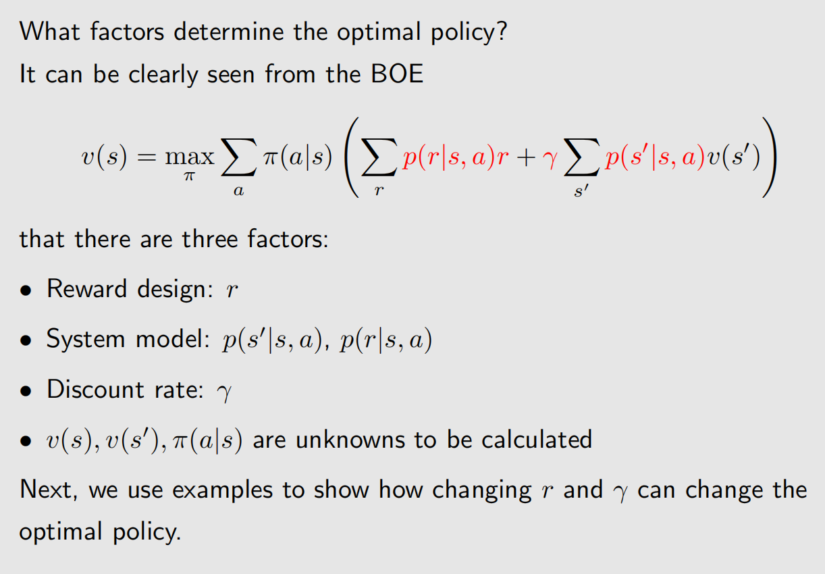
Analyzing optimal policies

Slide 34
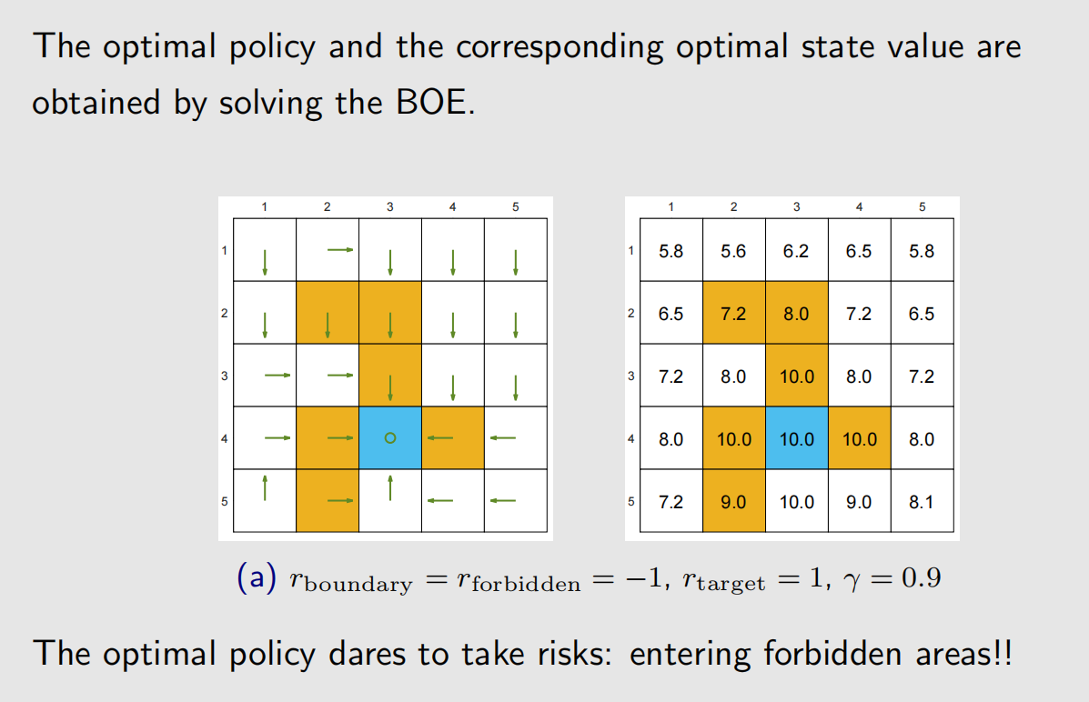
Analyzing optimal policies

Slide 35
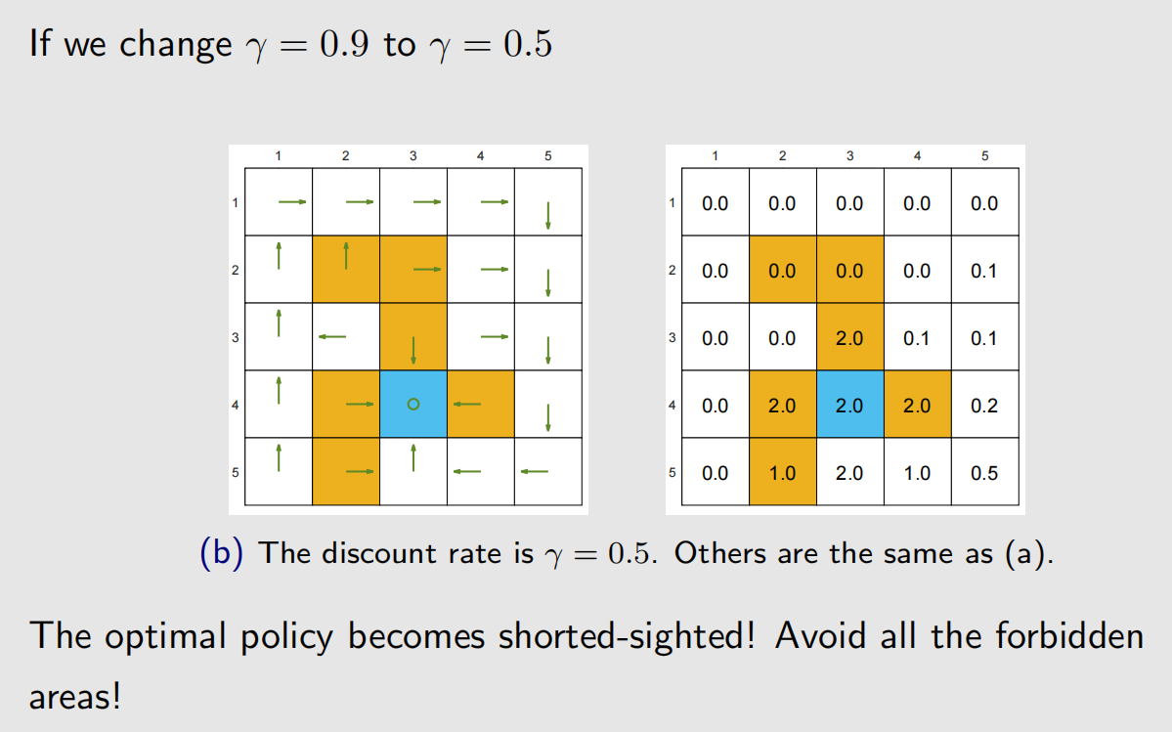
Analyzing optimal policies

Slide 36
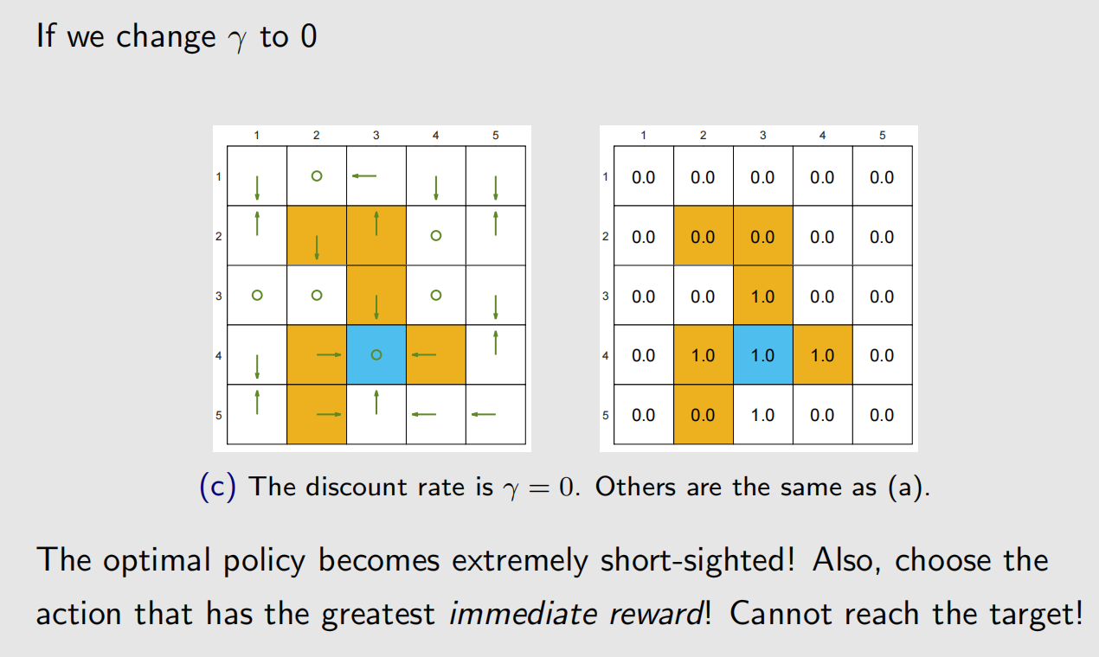
Analyzing optimal policies

Slide 37
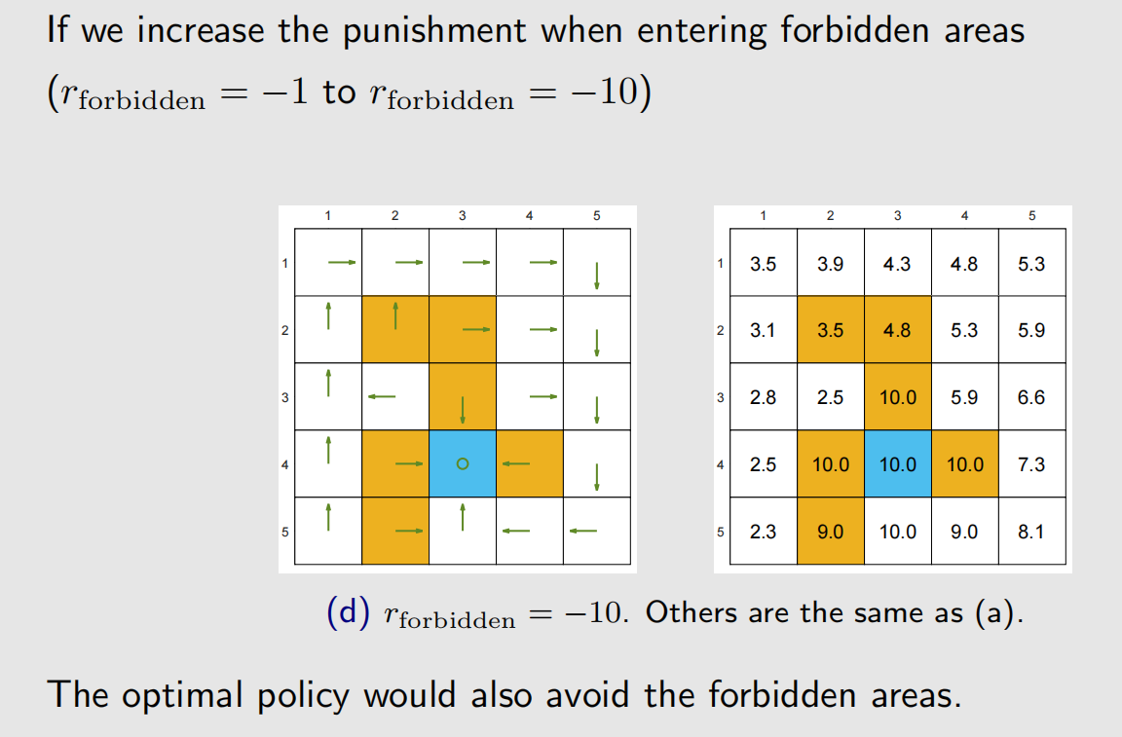
Analyzing optimal policies

Slide 38
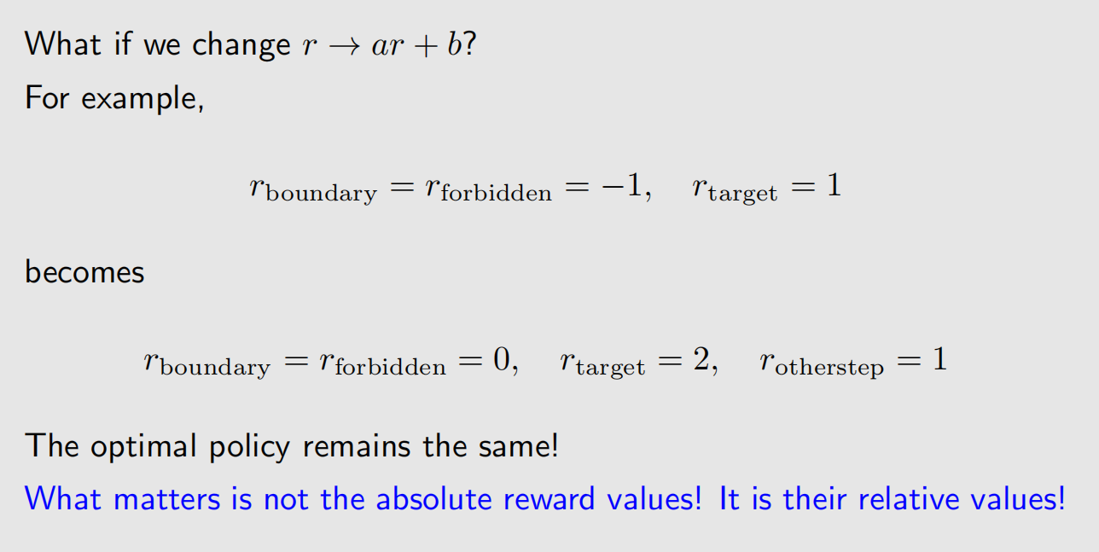
Analyzing optimal policies

Slide 39
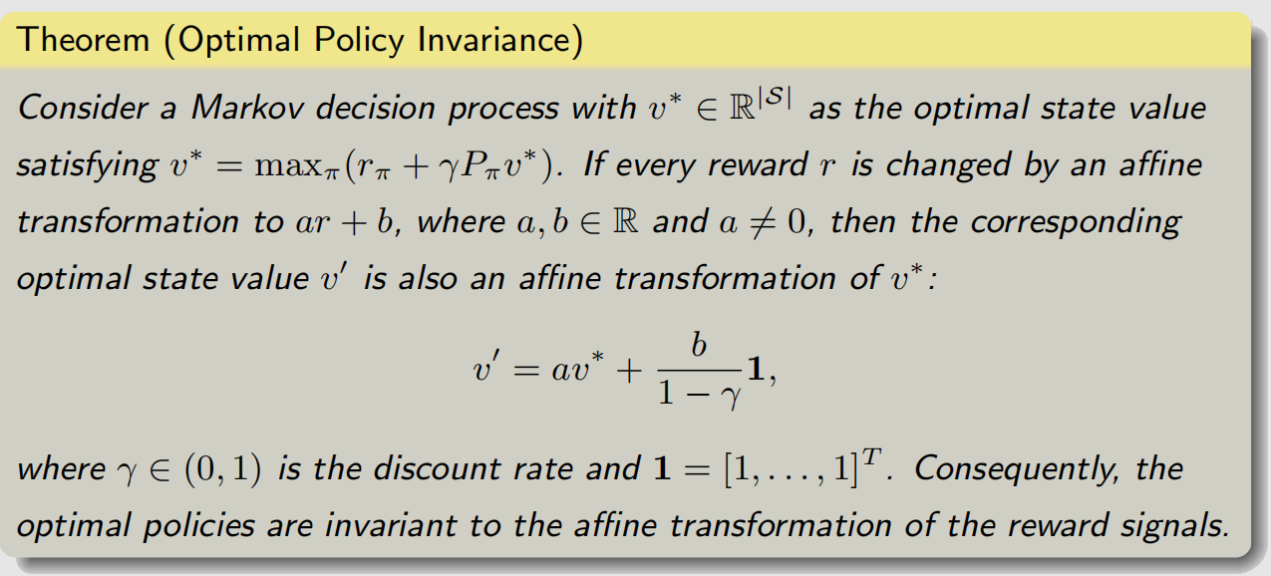
Analyzing optimal policies

Slide 40
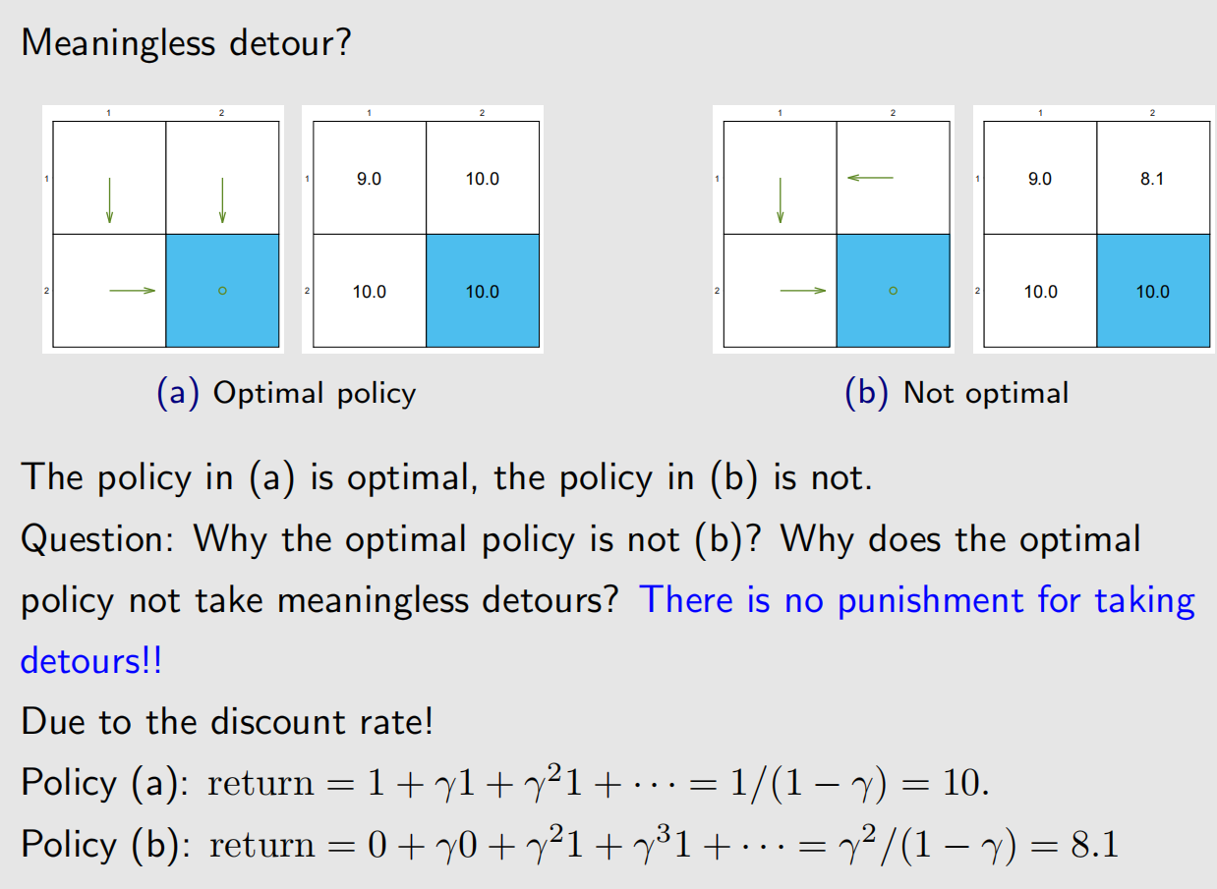
Analyzing optimal policies

Slide 41
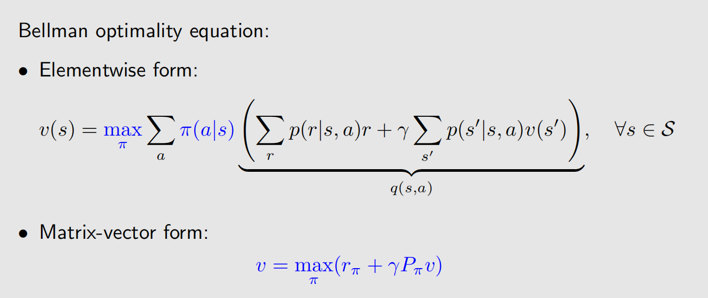
Smmary

Slide 42
Smmary
Questions about the Bellman optimality equation:
• Existence: does this equation have solutions?
• Yes, by the contraction mapping Theorem
• Uniqueness: is the solution to this equation unique?
• Yes, by the contraction mapping Theorem
• Algorithm: how to solve this equation?
• Iterative algorithm suggested by the contraction mapping Theorem
• Optimality: why we study this equation
• Because its solution corresponds to the optimal state value and optimal policy.
Finally, we should understand why it is important to study the BOE!

